Slide 1
Missing People
www.missingpeople.org.uk
Notes:
Hi, lovely to meet you all…….. Etc……..
We’re here to talk to you about our charity Missing People.
This is our phone number, lots of people call us to get help.
*Ask pupils to take a good look at the screen for a few seconds. We can then go back to this at the end and ask if anyone can remember the telephone number?

Slide 2
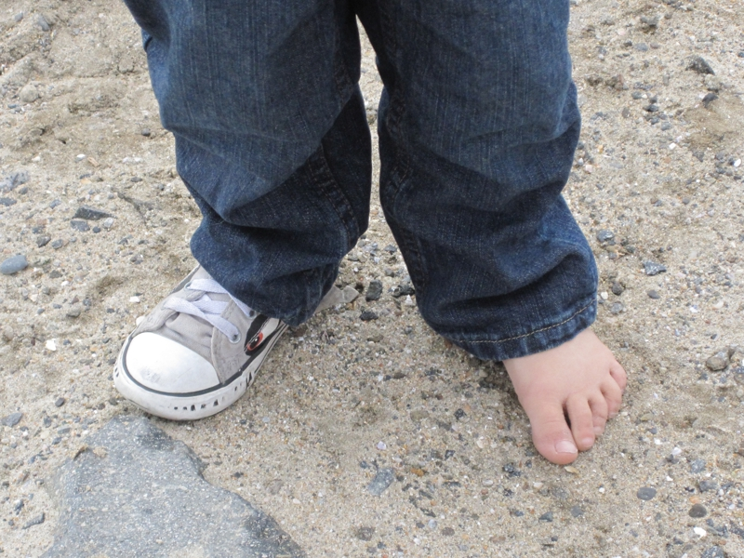
Can you spot what is missing?
Notes:
Explain what missing is – “missing means that something that should be there is not”
Can you spot what is missing in each of these pictures?
Explain that without the ‘missing’ part the jigsaw puzzle isn’t complete. And the child cannot walk or run properly with only one shoe.

Slide 3
What do you think a missing person is?
Notes:
Ask the kids first
A person is missing when there family and friends don’t know where they are. They will get worried about them and tell the police and us. Someone can be missing for half an hour or they can be missing for much longer.
This can be really scary for the family and for the person that has gone missing – they might not know how to get back to their family
There are lots of different reasons why someone might go missing. I will tell you a few of these later on.
Missing People is the charity we work for. A charity is basically a big company that sees a problem and tries to help fix it. At Missing People we are all about helping people. We want to help people that have gone missing and we want to help the families that are waiting to see them again.

Slide 4
How many people go missing?
250,000 people go missing every year
That’s one person every two minutes
140,000 children go missing
99% are found in less than a year

Slide 5
Why is being missing unsafe?
Not feeling well and
need to be looked after
Unsafe adults
Help with safe
and clever decisions
Notes:
Talk through the reasons why missing is unsafe.
If you start to not feel well and need to be looked after but no one is around to help
Sometimes people are with adults who are unsafe and can’t look after them
If you’re not with anyone you trust then there’s no one to help make safe decisions like when to cross the road

Slide 6
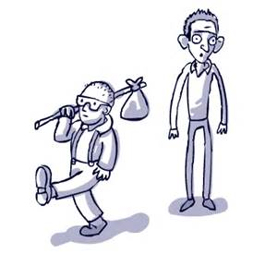
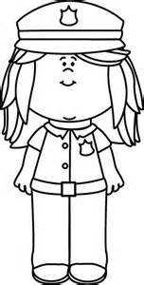
Why do some people go missing?
Some people leave because they’re scared or sad and we need to help them be safe.
Sometimes they’re not very well and we need to make sure they get home safely.
Sometimes they get taken away and we have to help the police get them back.
Notes:
Ask kids for their ideas first
Talk through reasons that people go missing

Slide 7
How do we help?
Website
Talking
and listening
Posters and TV
Police
Notes:
We help people when they are missing by:
We have lots of helpful information on our website.
Most people need to talk if they ever have any problems or they’re scared. Anyone can call us, any time, even in the middle of the night when everyone is sleeping and they can talk to us.
We can put up posters of someone who is missing so everyone can see their face and help look for them. Sometimes we can even get photos of the person on to the TV so even more people can help.
The police do lots of work looking for people when they are missing. We help them when we can.
We help families when someone goes missing too.
This is because it is really sad and scary if someone you love goes missing. We will spend lots of time talking to people when they feel like this and try to help them however we can.
When someone is missing their families want to do everything they can to help find them. Sometimes they need help because they can’t do as much as they want so we will help.

Slide 8
Tara’s story
Tara was only 13 when she went missing
She had left home without her phone and her family were really worried
Posters, Twitter and Facebook
Two days later Tara was found safe!
She is now home with her family

Slide 9
How to keep safe
Don’t walk off anywhere with an adult
you do not know and trust.
If you ever feel scared, or get a worried
feeling in your tummy, when you are
with a new adult then tell an adult you trust.
Always tell your parents or an adult
you trust where you’re going and
what you’re going to be doing.
Notes:
It’s really important that you always keep yourself safe.
Talk through the 3 points

Slide 10
What can you remember?
What was the telephone number on the first slide?
www.missingpeople.org.uk
Notes:
Ask for hands up if they can remember the telephone number (116 000) for Missing People.

Slide 11
Thank You!
Notes:
Thank you so much for listening to us today. It was really nice to meet you all and we are so happy that you’re going to be helping us this year.

