Slide 1
Notes:
Hi, my name is PC ____________________
I’m here today to discuss how to have fun and stay safe on Halloween and Bonfire Night this year.

Slide 2
Notes:
I’m sure most of you enjoy dressing up in fancy dress, especially on Halloween. It’s a time to have fun!
You can enjoy dressing up, carving pumpkin lanterns and playing games…
Some children also go out in the neighbourhood to ’Trick or Treat’ or have Halloween parties.
Everything is exciting and fun, but it is important to know how to keep safe.

Slide 3
Notes:
There are some things you should always remember if you go out trick or treating.
It’s always best to go with and adult. However, if you are old enough to go out on your own, always tell your mum or dad or carer exactly where you are going
Stay close to home and if it is dark – its time to go home!
Stay with your friends and never go off on your own!
Never go inside anyone’s house. If you are invited – always say NO!
Take a mobile phone with you so you can call your family if you are in trouble.
Remember it’s always best to have an adult you trust to go out with you. You can all have fun together!

Slide 4
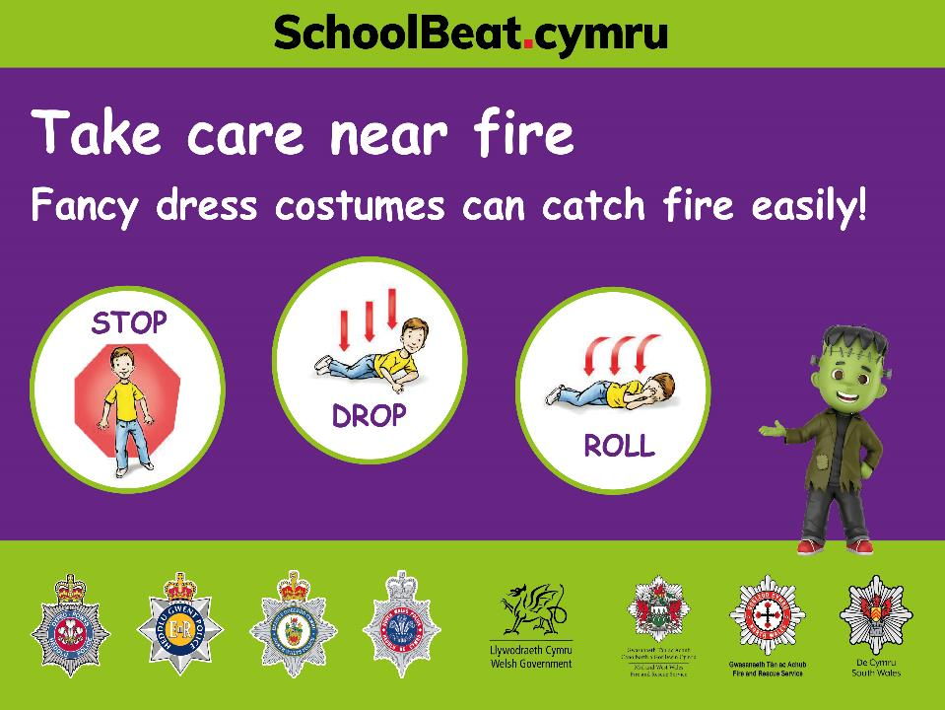
Notes:
Many fancy dress costumes can catch fire easily, so if you are wearing one, be extra careful around fires, flames and fire works.
If your costume ever caught fire then you should –
Stop moving,
drop to the floor and
roll over and over till the flames go out.

Slide 5
Notes:
Not everyone enjoys Halloween.
If people don’t answer the door it is polite to leave quietly.
If you see a “No callers” sign, please don’t knock on the door. Move on. Don’t be a little monster!

Slide 6
Notes:
The 5th of November is Bonfire Night.
This is also known as Guy Fawkes or Firework Night!
This another chance to enjoy and have fun!
The fire service have asked us this year to emphasise that an organised display is the safest way to enjoy fireworks. They are also lots of fun!

Slide 7
Notes:
Think of what you enjoy doing on Bonfire Night.
Have you ever been to an organised Fireworks display? They are amazing aren’t they?
There are very important safety rules we must all follow when children and adults are near fireworks and bonfires and also when using sparklers.
The next slide gives advice to children on how to stay safe on fireworks night.

Slide 8
Notes:
Here are some tips to help you to keep safe:
Always stand well back from bonfires and fireworks
Never play with fireworks or go near a firework once it’s been lit
Never put fireworks in your pocket
Always wear gloves. It’s safer if you are given a sparkler!
Never touch a sparkler that has gone out – it could still be VERY hot!
Stay close to the adults you are with. It’s a good idea to arrange a meeting place you all know to meet should you get separated.
If you do get burnt, get help immediately and call 999.
If it is a small burn – put the affected area into cold water or under a tap of cold running water for 5–10 minutes.

Slide 9
Notes:
Did you know?
Many pets are afraid of fireworks noise.
Always make sure your pets are safe at home in a quiet place.
They can be very frightened by the noise and could be injured by bonfires and fireworks.

Slide 10
Notes:
So, this year, make sure you stay safe and if you can, enjoy an organised fireworks display with your family and friends.
Looking after ourselves, others and the emergency services have never been more important.
Respect each other, protect the emergency services, and enjoy safely.

