Slide 1
Deall radicaleiddio / eithafiaeth ar-lein
Understanding online radicalisation / extremism

Slide 2
Rhaglen Ysgolion Heddlu Cymru Radicaleiddio Ar-lein/ Eithafiaeth
Wales Police Schools Programme
Online Radicalisation / Extremism

Slide 3
Wales
Wales is one of the safest
places to live in the UK
Those living in Wales are least
likely to be a victim of crime
This Photo by Unknown Author is licensed under CC BY-SA-NC

Slide 4
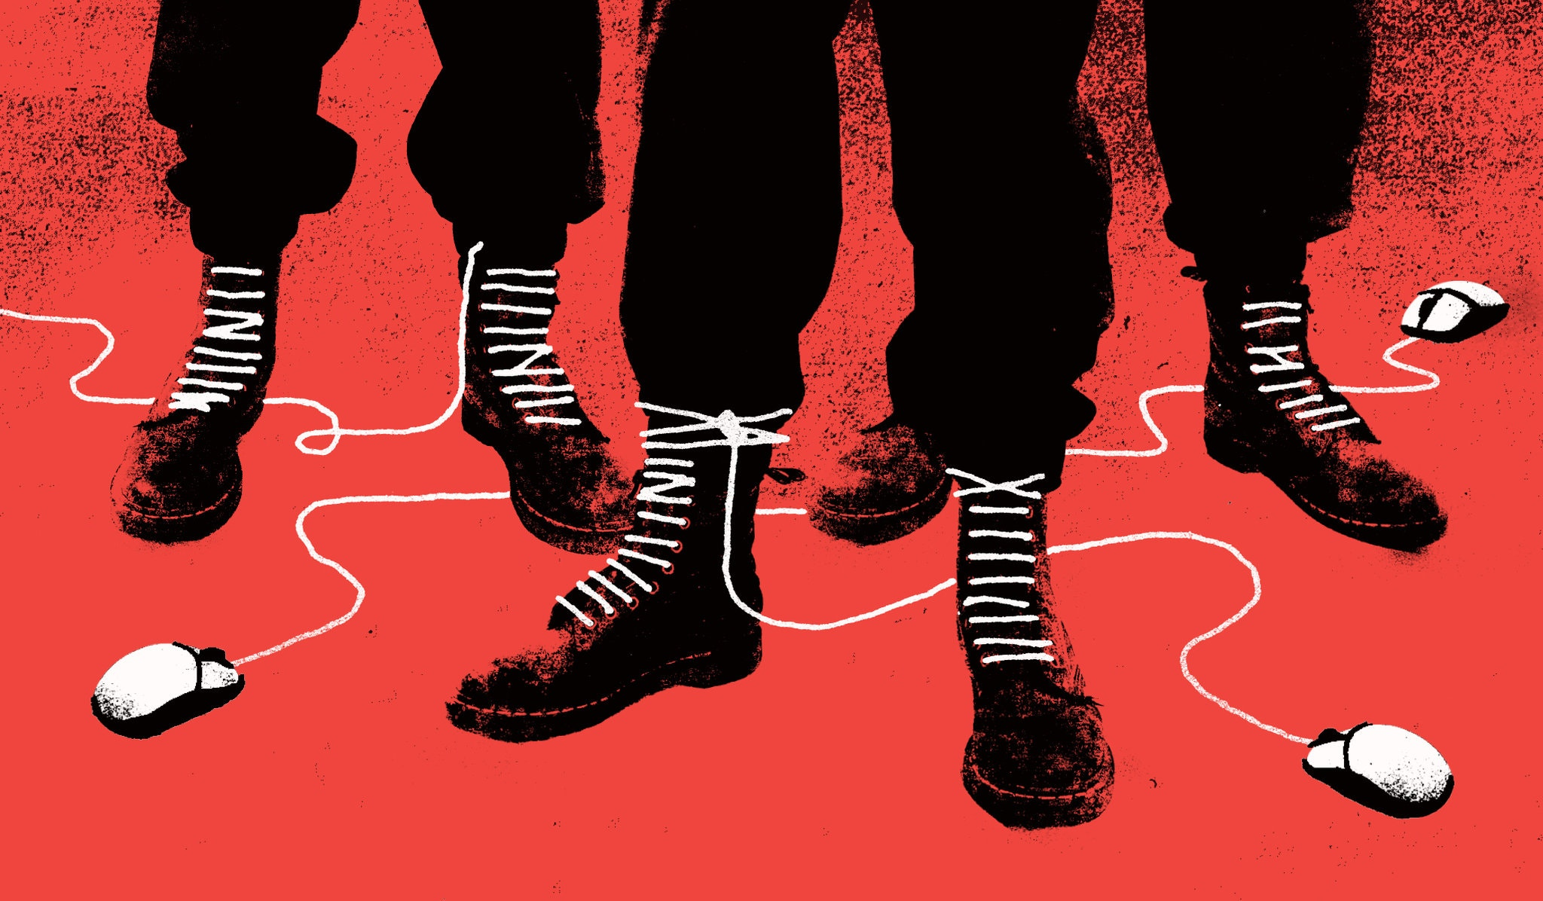
Radicalisation = when somebody is convinced to start supporting/believing extremist ideas. They are radicalised (or influenced) by others.
Extremism = having strong beliefs (about politics, religion or social issues) that most people don’t find acceptable / reasonable.

Slide 5
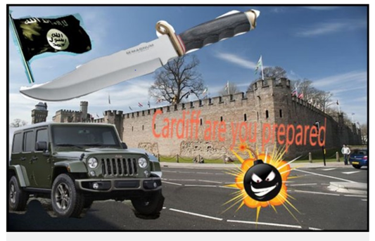
(Incel - Involuntarily celibate)

Slide 6
“Broken people dealing with identity crises… abuse, drug addiction, alcoholism, family poverty, those types of things”
“Kids with personal issues because it was easier to promise them paradise”

Slide 7
Low self esteem
Isolated
Uncertain
Confused
Need for acceptance and belonging
Perceived injustice in society and government decisions
Poor
mental
health
Anger and disrespect towards
family, friends and community
Easily influenced
Grief
Loss
ALN

Slide 8
Radicalisation happens gradually:
Targeted online grooming / exploitation
Psychological manipulation
Exposure to violent material and other inappropriate information

Slide 9
Spot the Signs
It might be nothing
It might be something
Social media
interaction
Loss of interest in friends and activities
Spending more time online
Becoming secretive
Have material or symbols linked with an extreme cause
Change in personal appearance
Challenging law
and order
Increased focus on extremist ideology, group, cause
Supportive of violence
Intolerance of difference

Slide 10
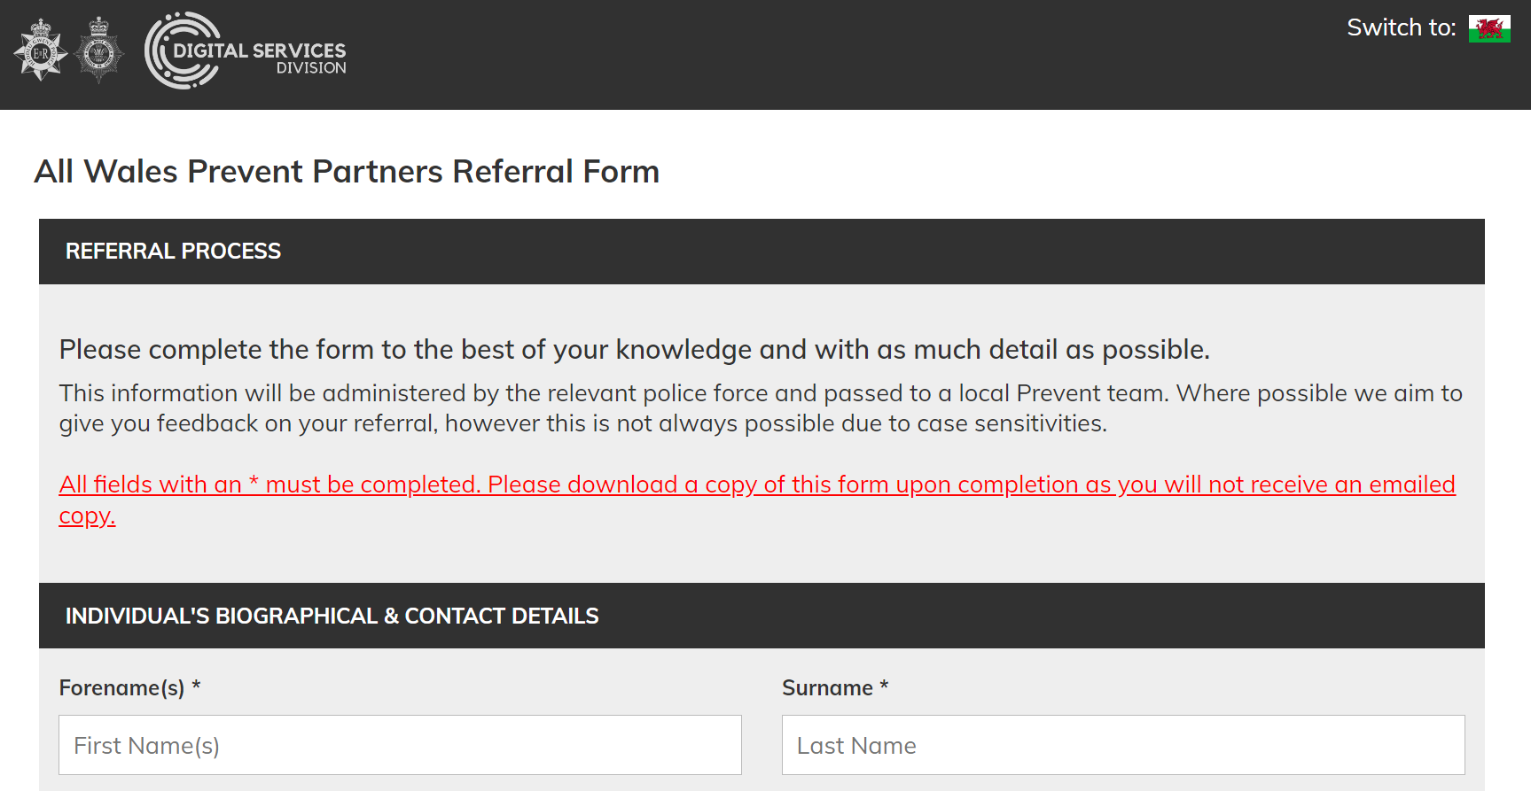
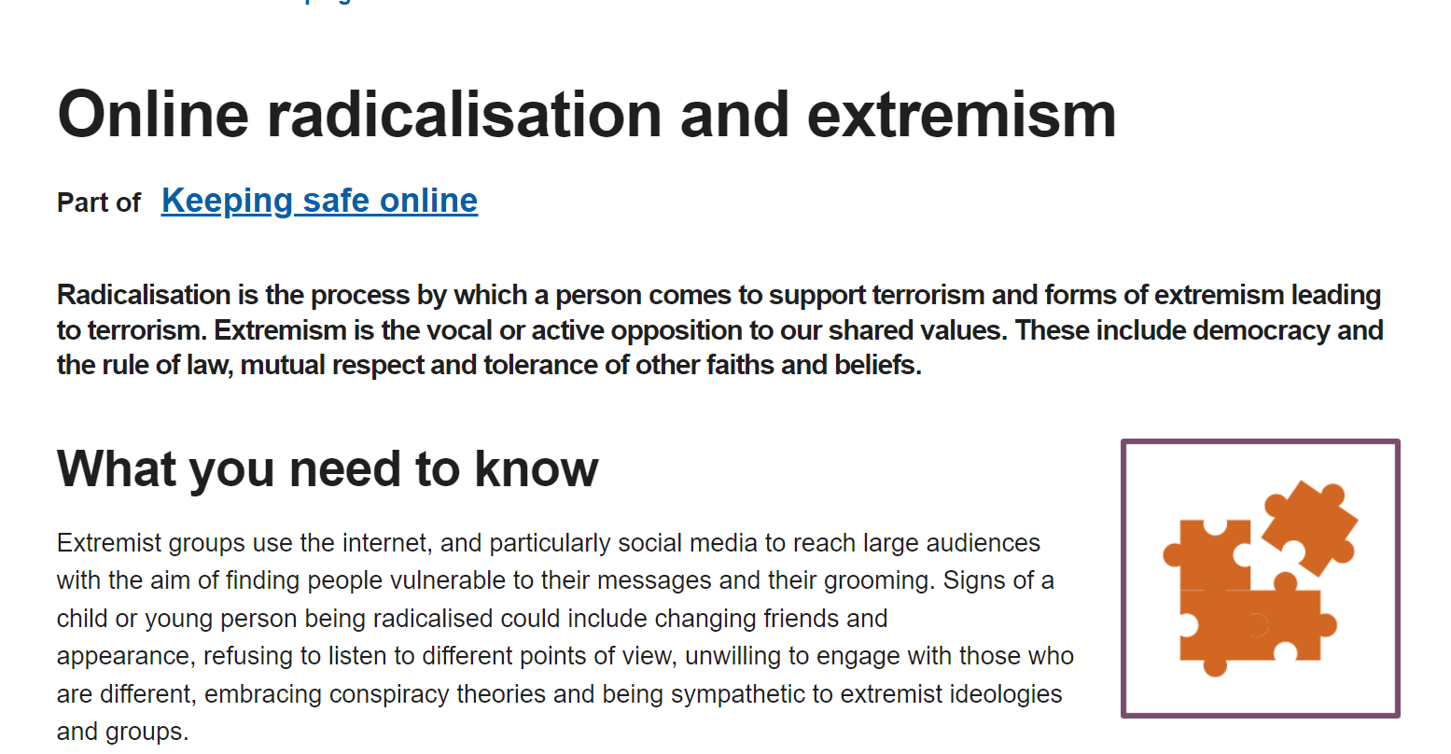
It might be nothing, it might be something.

Slide 11
Steps to take:
Statutory Duty to Report
Refer to DSP
Inform Parent/Carer
Notify LEA
Prevent Referral
Link in with SPO

Slide 12
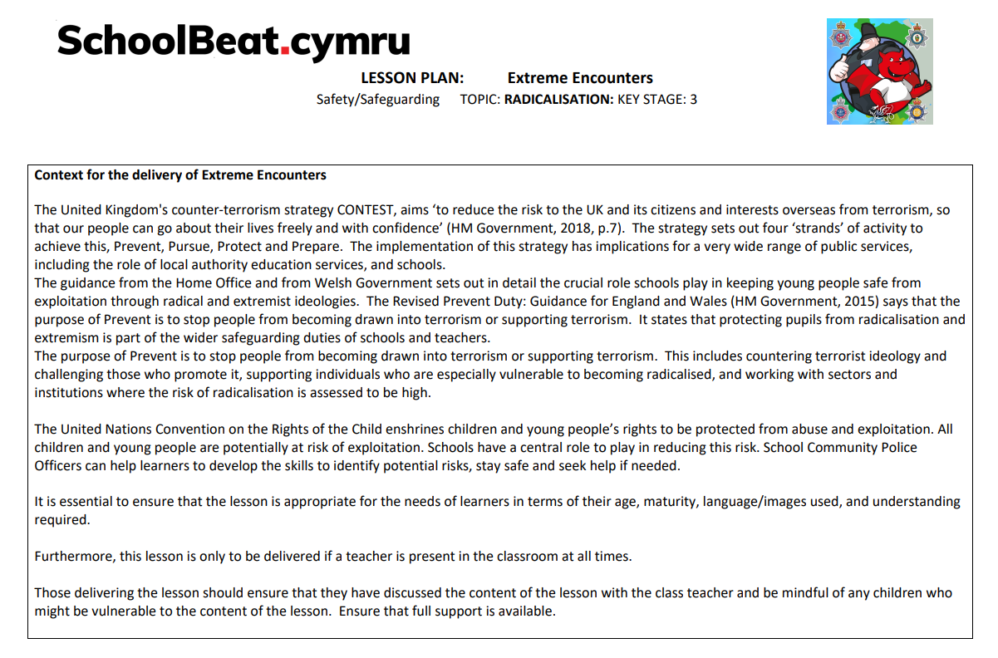
Wales Police Schools Programme

Slide 13
Help and Advice

