Slide 1
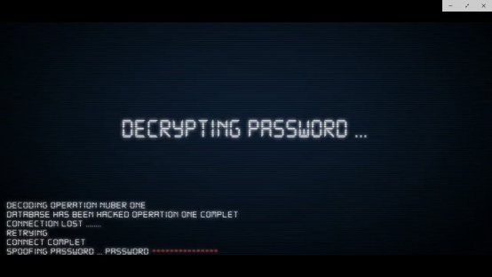
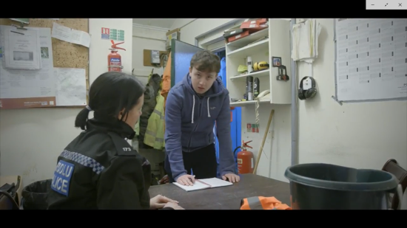
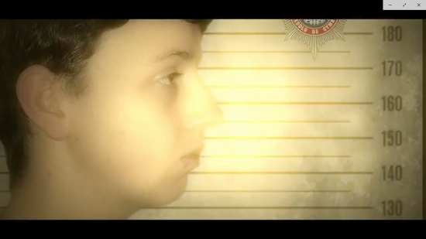
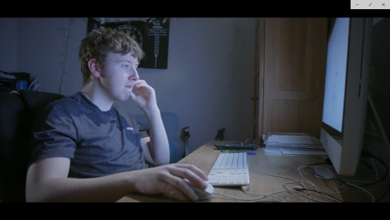
Peidiwch â Chamu at Seiber Droseddu Don’t Cross the Line to Cyber Crime
Adnodd 1 — Resource 1

Slide 2
Aim
To raise awareness of cyber crime

Slide 3
We are learning…
What cyber crime is
What the Law is in relation to cyber crime
How to use digital devices safely and responsibly
Why cyber crime is not a victimless crime
What future opportunities are open to young people with cyber skills
What to do when we need help.

Slide 4
Key Words
seiber drosedd
sgiliau seiber
canlyniadau
dioddefwr
cyber crime
cyber skills
consequences
victim

Slide 5
Agree or
Disagree

Slide 6
It’s okay to share your password with close friends.
Agree or
Disagree

Slide 7
It’s fun to guess someone else’s password.
Agree or
Disagree

Slide 8
It’s funny to post a status on my friend’s social media account without them knowing.
Agree or
Disagree

Slide 9
The best part of gaming is modifying them (modding).
Agree or
Disagree

Slide 10
Some cyber crime is harmless.
Agree or
Disagree

Slide 11
Cyber crime is…
committed when
digital devices are illegally used against other people or systems.

Slide 12
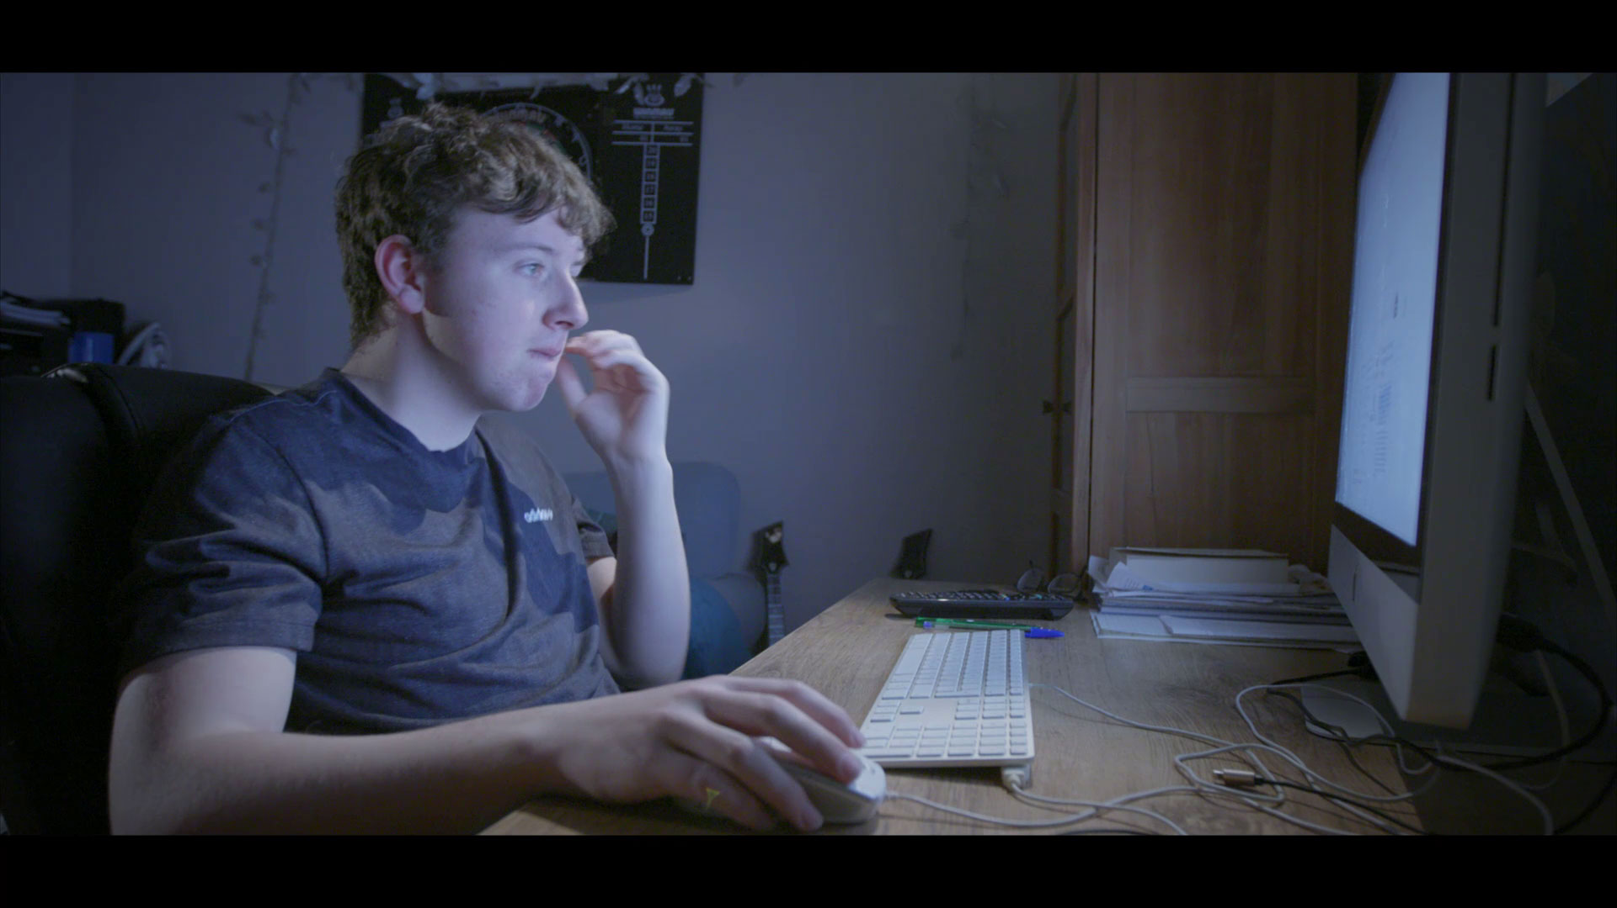
Don’t Cross the Line to Cyber Crime
schoolbeat.cymru/cyber-crime-film

Slide 13
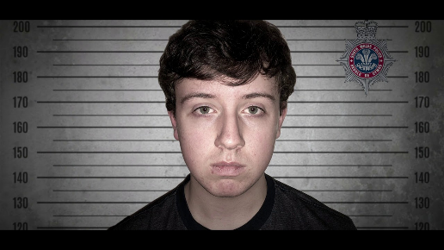
Jigsaw activity
When was the wrong choice made?
What happened?
Who?
Why?
When did he break the Law?
What were the consequences?

Slide 14
Who?
Jack was playing online games with his friends.
What happened?
Jack committed cyber crime.
When was the wrong choice made?
Jack chose to use cheats to beat the system. It was all about cracking the code.
Jack joined chat rooms where he learnt tricks from other like-minded people.
Why?
Jack became addicted to online gaming.
Jack believed he would not be found out.
When did he break the law?
Jack used his friend’s password to buy game ammunition.
While online, Jack stole his friend’s gold.
Jack was hacking people’s accounts and threatening them to demand money.
Jack disabled his school’s website which caused mayhem!
Consequences
Jack was arrested and charged with cyber crime offences. He had lied, had no job and no career.
Jack was found guilty of cyber crime offences and given a suspended prison
sentence and 150 hours of community service.

Slide 15
When did Jack start to break the Law?

Slide 16
Consequences Scenarios

Slide 17
Scenario 1
Jack broke the law by using his friend’s password to buy game ammunition.
Who are the victims?
How were they affected?

Slide 18
Scenario 2
Jack broke the Law by threatening people to demand money.
Who are the victims?
How were they affected?

Slide 19
Scenario 3
Jack broke the law by
disabling his school’s website.
Who are the victims?
How were they affected?

Slide 20
Pathways to success How you can use your cyber skills
Cyber security includes the use of technology and skills to protect systems, networks and data from attack.
Ethical Hacker £50K
Information Security Manager £70K
Game Developer £50-60K
Cyber Crime analyst £35K
Forensics Investigator £40K
Web Vulnerability Analyst £30K
Data Miner £35K
If you have the skills there are lots of jobs that pay well!

Slide 21
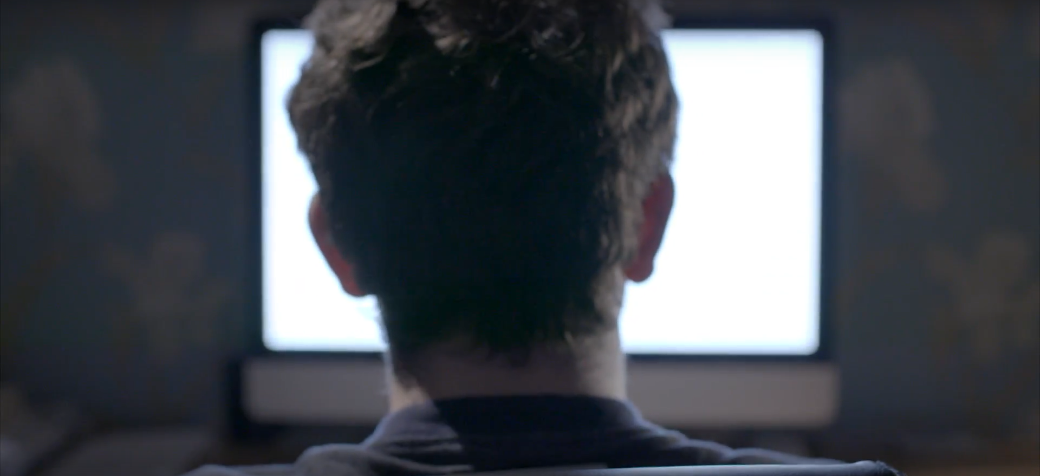
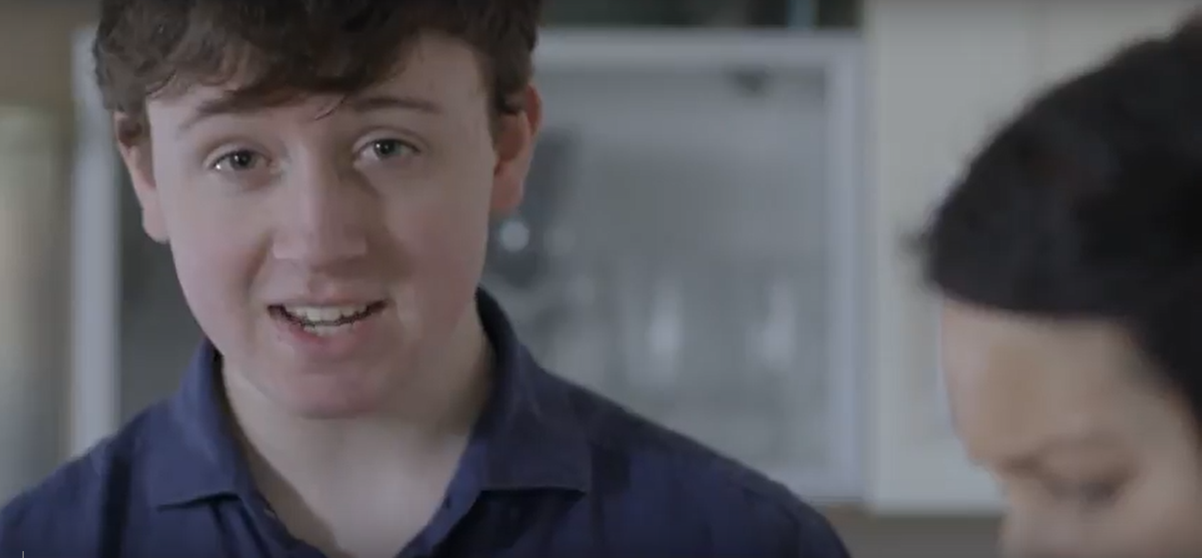
What have you learnt today?
After today’s lesson I now know…

Slide 22
After this lesson I…
can explain what cyber crime is
can identify the steps that could lead to criminal activity online
know the Law relating to cyber crime
understand that cyber crime is not a victimless crime
am aware the career opportunities open to me
know who to go to for help

Slide 23
Help and Support
Trusted adults
Teacher or
Designated
Safeguarding Person
School Community
Police Officer
Local Cyber Crime Team

