Slide 1
Rhedeg i Drwbwl
Gangiau Stryd a Llinellau Sirol
Running Into Trouble
Street Gangs and County Lines

Slide 2
Aim
To raise awareness of street gangs and County Lines

Slide 3
Learning Outcomes
What is ‘County Lines’?
What Is Criminal Exploitation?
Signs of Criminal Exploitation
The Law
Stop Search
Drug Classifications
What help is available

Slide 4
Geiriau
Allweddol
Key
Words
Llinellau Sirol
Camfanteisio Troseddol
Atal ac Archwilio
Meithrin perthynas amhriodol
Deliwr cyffuriau
County Lines
Criminal Exploitation
Stop Search
Grooming
Drug dealer

Slide 5
County Lines…
is a term that describes the organised, illegal movement of drugs, from the big cities into smaller towns and rural areas, by street gangs, using children and vulnerable adults.

Slide 6
Criminal Exploitation…
is when a child or young person is befriended and abused, taken advantage of, groomed and controlled for a criminal purpose.

Slide 7
Bullied/ Vulnerable/ Lonely
Travelling alone on trains
Staying out late
challenging behaviour
Using illegal drugs
Disrespect for boundaries set by parents / carers or school.
Have more money/ unexplained gifts
Signs of Criminal Exploitation
Carrying drugs
Carrying weapons
Missing school
Being secretive about where they have been or are going to
Travelling between towns and cities
Sleeping in a drugs den
Lack of interest in school, activities and hobbies
Made to feel safe
and protected
Being forced to help
prepare drugs
Taking risks

Slide 8
The Law
The actions by adults are CRIMINAL –
and they are BREAKING THE LAW.
The LAW is there to protect children and young people under the age of 18.

Slide 9
‘No child can consent to criminal exploitation and it’s never their fault!’

Slide 10
Stop and Search
A 'stop and search' is when a Police Officer stops you and then searches you, because he or she has reason to suspect you are in possession of drugs, weapons, stolen property or items which could be used to commit a crime.
Only a Police Officer can stop and search you.
They must:
Explain why you are being stopped and searched, what they are looking for and the law under which you are being searched.
Give you their name, force or collar number and police station
Give you with a stop and search receipt or record which will include the date and time of search
Being stopped by a Police Officer does not mean you are under arrest or have necessarily done something wrong.

Slide 11
Possession with Intent to Supply
Supply/Manufacture
or Cultivation
Possession
C
2 years and/or fine
14 years and/or unlimited fine/seizure of assets
B
5 years and/or fine
14 years and/or unlimited fine/seizure of assets
A
7 years and/or fine
LIFE and/or unlimited fine/seizure of assets

Slide 12
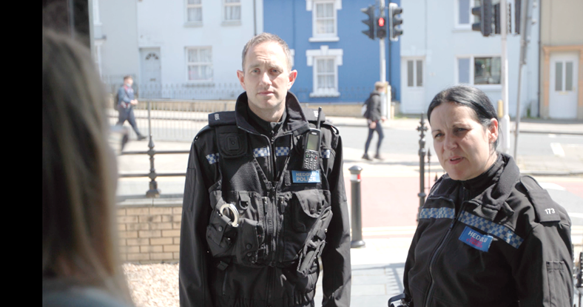
Help and support is available
A teacher or the school DSP, School Counsellor or Nurse
Your School’s Police Officer
www.fearless.org
A family member you trust

