Slide 1
Do you agree or disagree?
(3h) Extreme Actions

Slide 2
Activity
In small groups discuss the 11 pictures and place them on the continuum provided
Too
extreme__________Acceptable
Notes:
N.B. the bar will move across the continuum to illustrate varying opinions on this slide. CLIC and wait a few seconds!

Slide 3
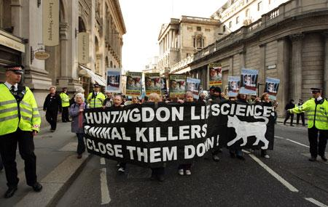
LEGAL - Demonstration in arrangement with the Council, Local Authority and Police
Notes:
Animal Rights Activists The protest is legal because the march has been arranged with the permission of the Council, Local Authority and the Police. Certain conditions may have been applied such as route, time and length of march.
3

Slide 4
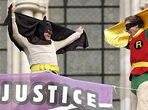
ILLEGAL – Public Order Offence
Notes:
New Fathers 4 Justice protesters have climbed up a public building. They do not have permission to do this.
In this photograph the men had climbed onto Buckingham Palace.
4

Slide 5
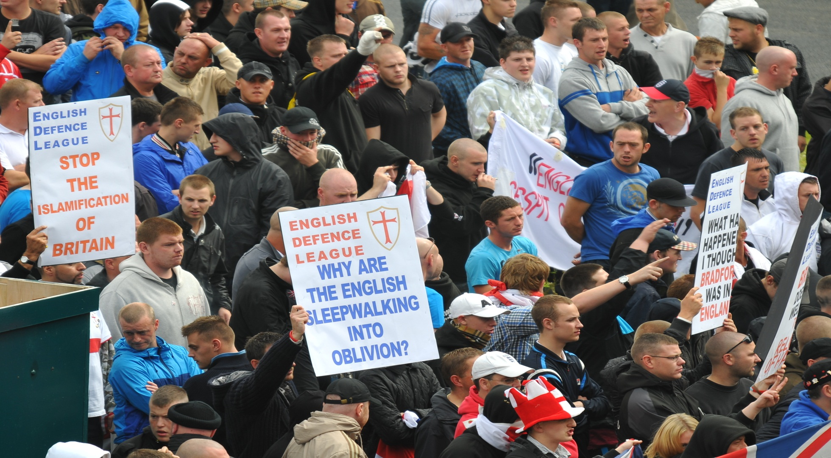
LEGAL – Demonstration in arrangement with Council, Local Authority and Police.
Notes:
English Defence League protest. This is a legal protest because in this picture nothing offensive is displayed.

Slide 6
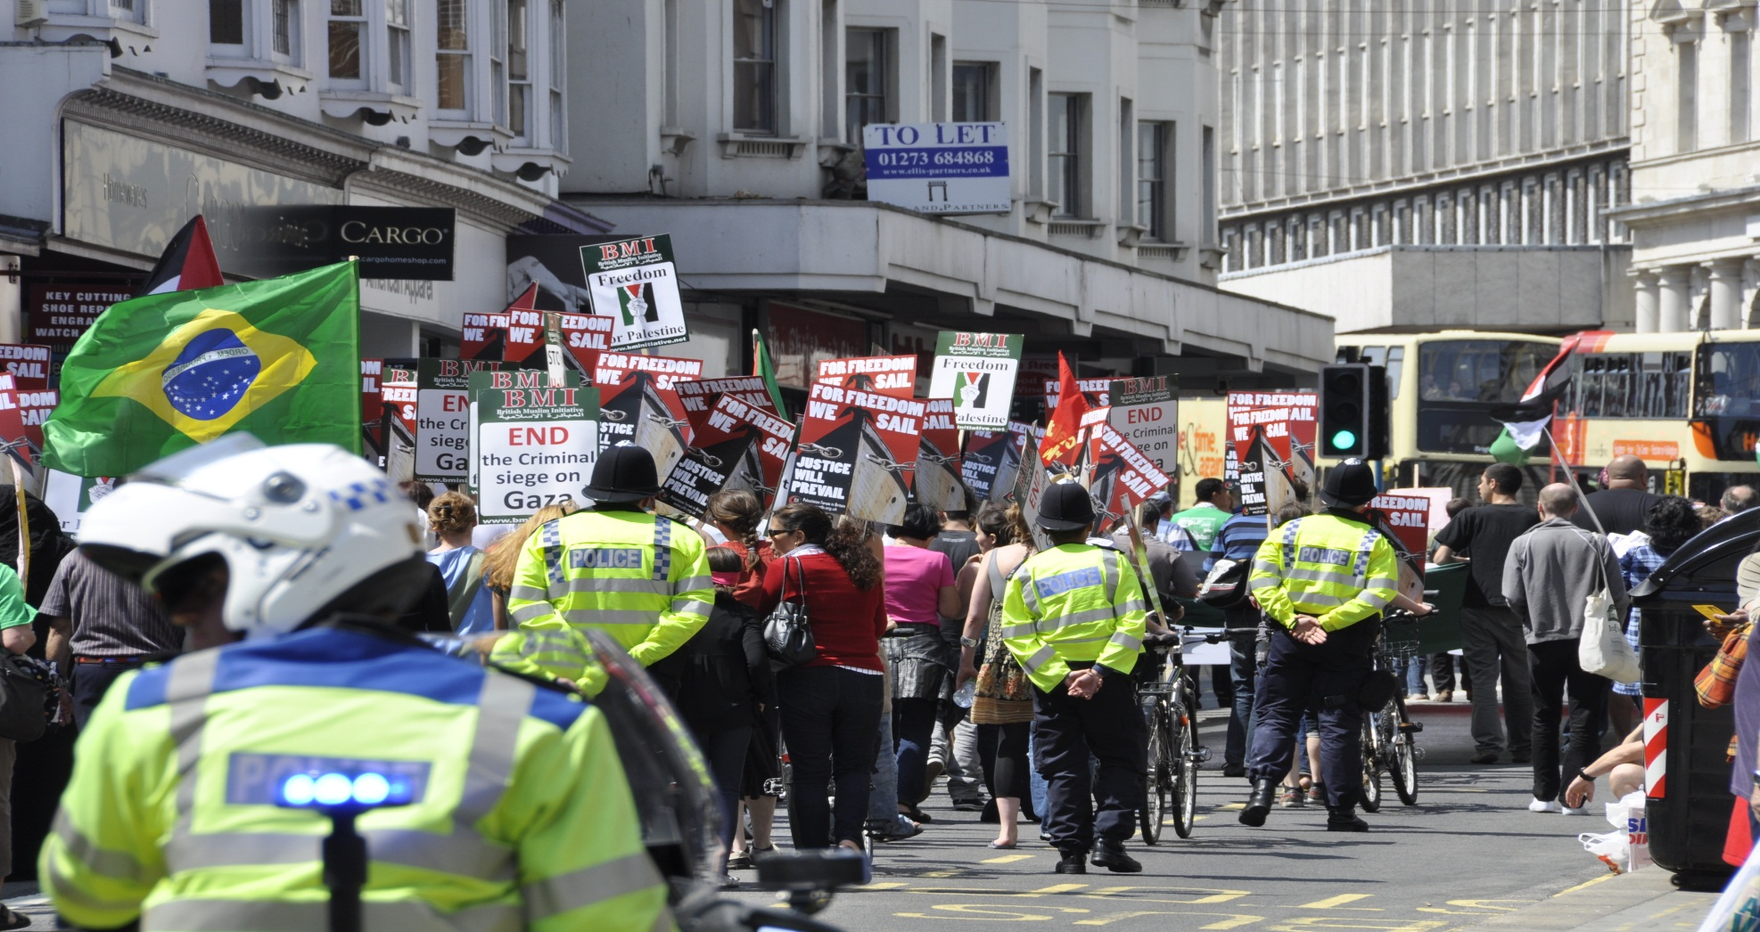
LEGAL – Demonstration in arrangement with Council, Local Authority and Police.
Notes:
Pro Palestinian/Anti Israeli protest.
Legal as long as the conditions of the permission to march and protest are not broken.

Slide 7
ILLEGAL – Racially Aggravated Public Order Offence, Racial Hate Crime

Slide 8
ILLEGAL – Public Order Offence Obstruction, Damage to Road Surface
Notes:
Protesters have caused damage to property and are blocking the road.

Slide 9
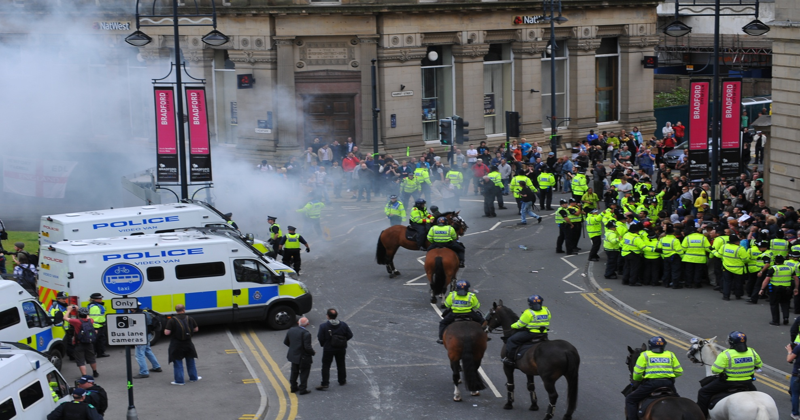
ILLEGAL – Public Order Offence Smoke bomb thrown. Protesters have failed to comply with the conditions of permission to protest
Notes:
A legal demonstration becomes illegal when protesters stop complying with the conditions of the permission to protest.
In this photo we see that a smoke bomb has been thrown and that the police have penned in protesters to try to prevent further disorder.

Slide 10
ILLEGAL – Public Order Offence Racial Hate Crime, Criminal Damage
Notes:
K K K
Ku Klux Klan an illegal white supremacist, organisation mainly based in the USA.
This was painted on a wall in Swansea and represents hatred towards all non whites.
The swastika (Symbol of the Nazi right wing extremist movement) is a an example of Racial Hate Crime

Slide 11
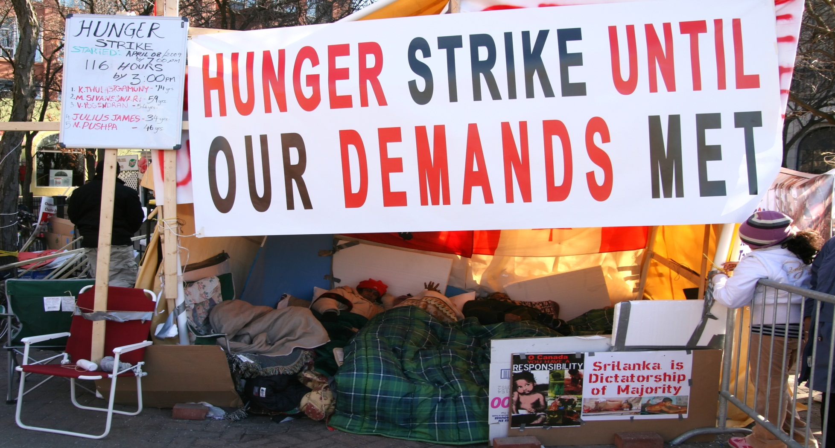
ILLEGAL – Obstruction of the Highway
Notes:
Hunger strike. It is not illegal for a person to decide to go on hunger strike.
Obstructing a public highway is illegal.

Slide 12
LEGAL - Demonstration in arrangement with the Council, Local Authority and Police
Notes:
Climate Camp is an anti-carbon fuels and global warming group.

Slide 13
ILLEGAL – Homophobic Hate Crime Criminal Damage
kill gays

