Slide 1
(5b) Photographs: Planning a campaign

Slide 2
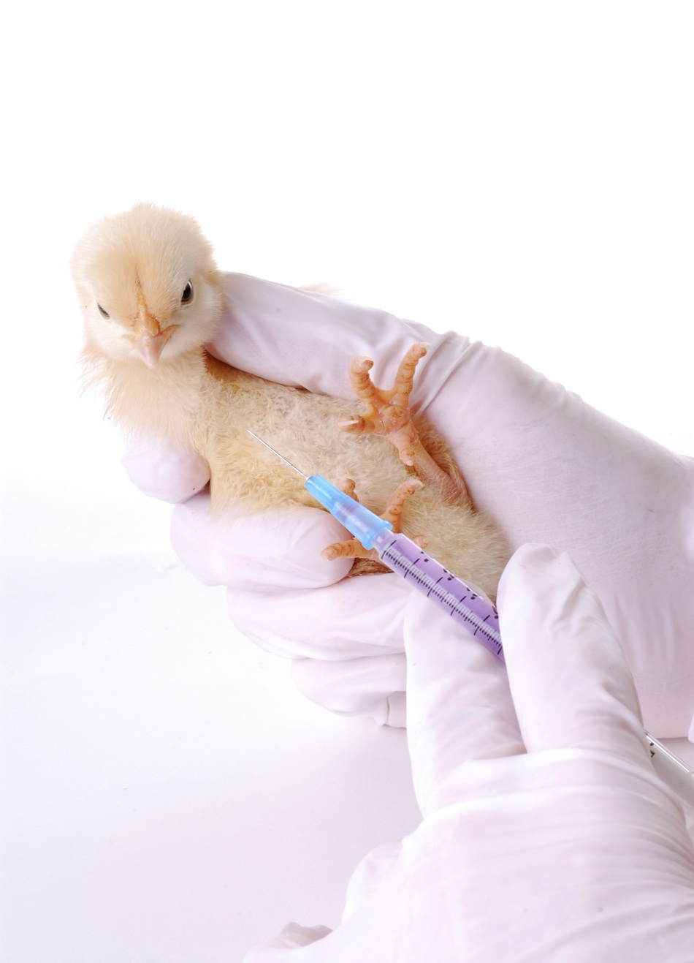
Animal testing

Slide 3
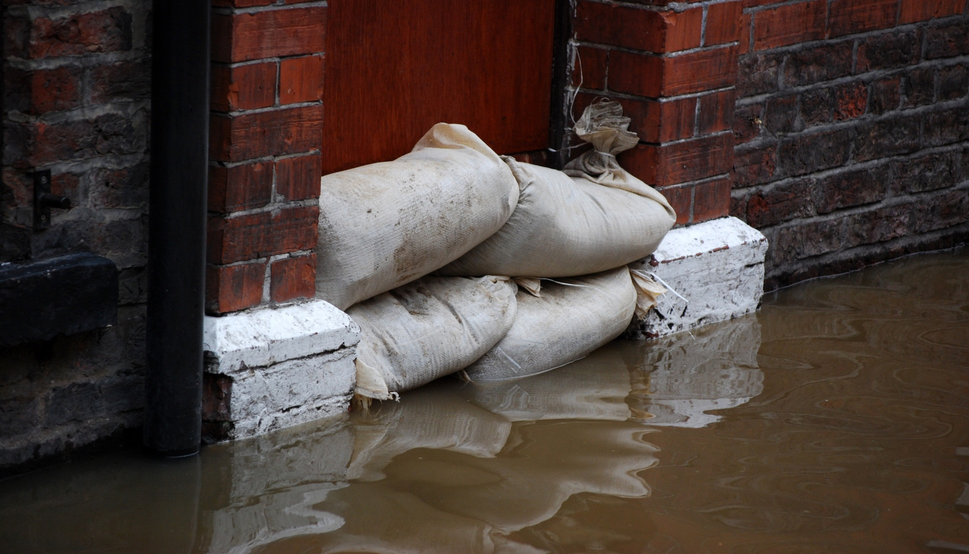
Flooding (Climate change)

Slide 4
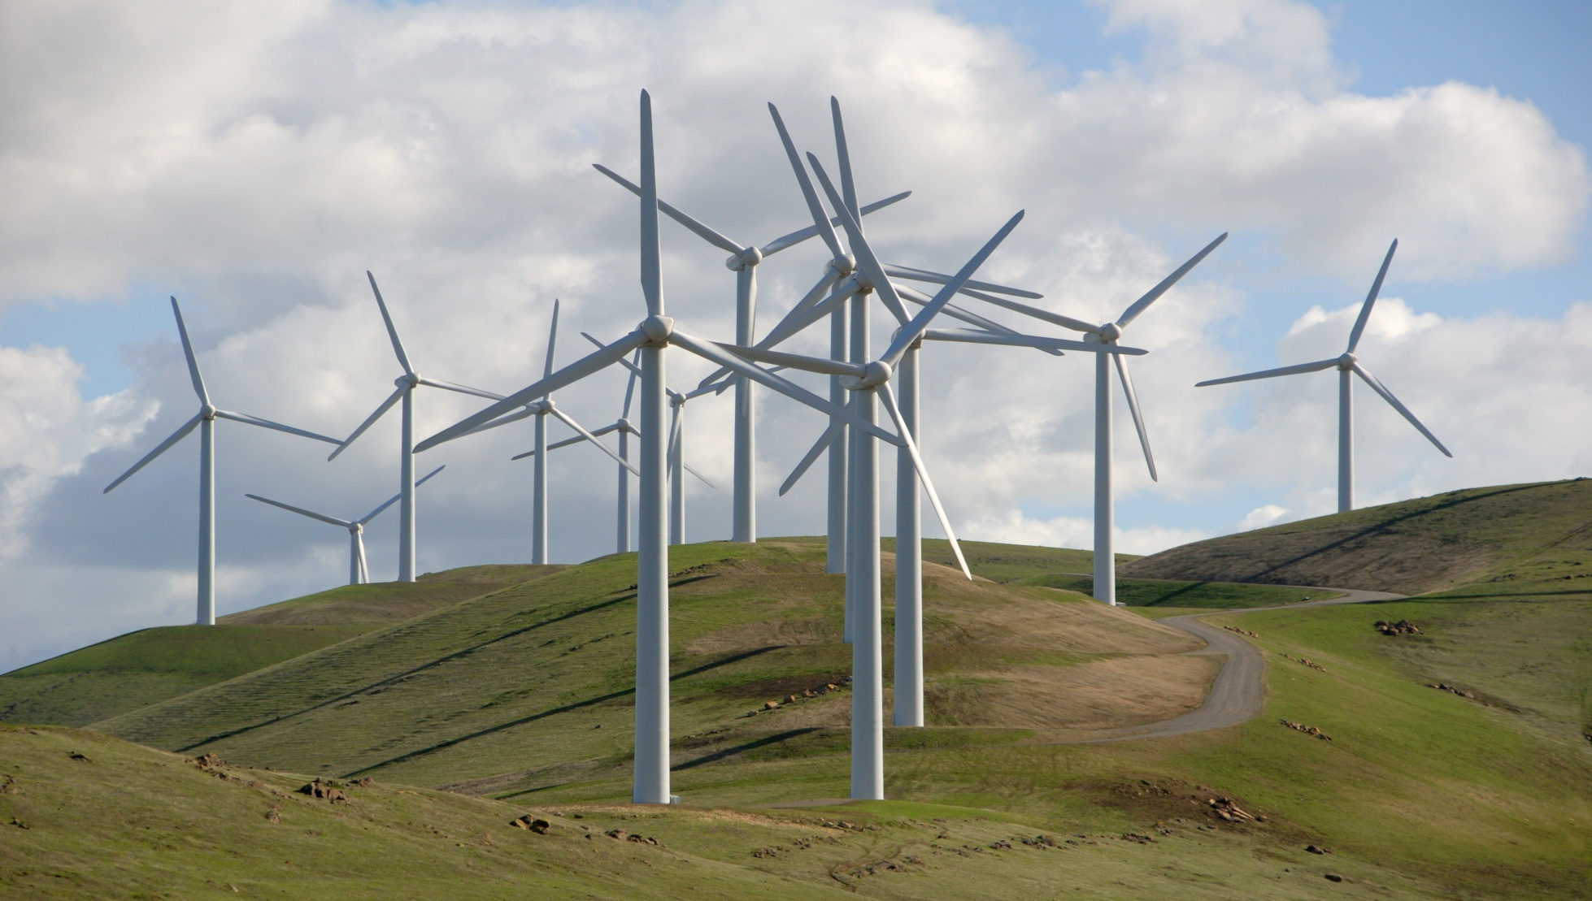
Wind power/Visual pollution

Slide 5
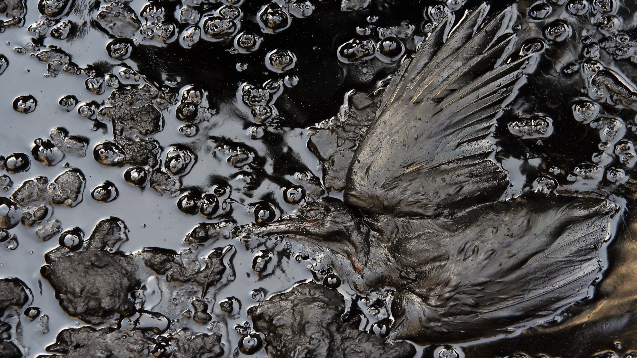
Oil pollution

Slide 6
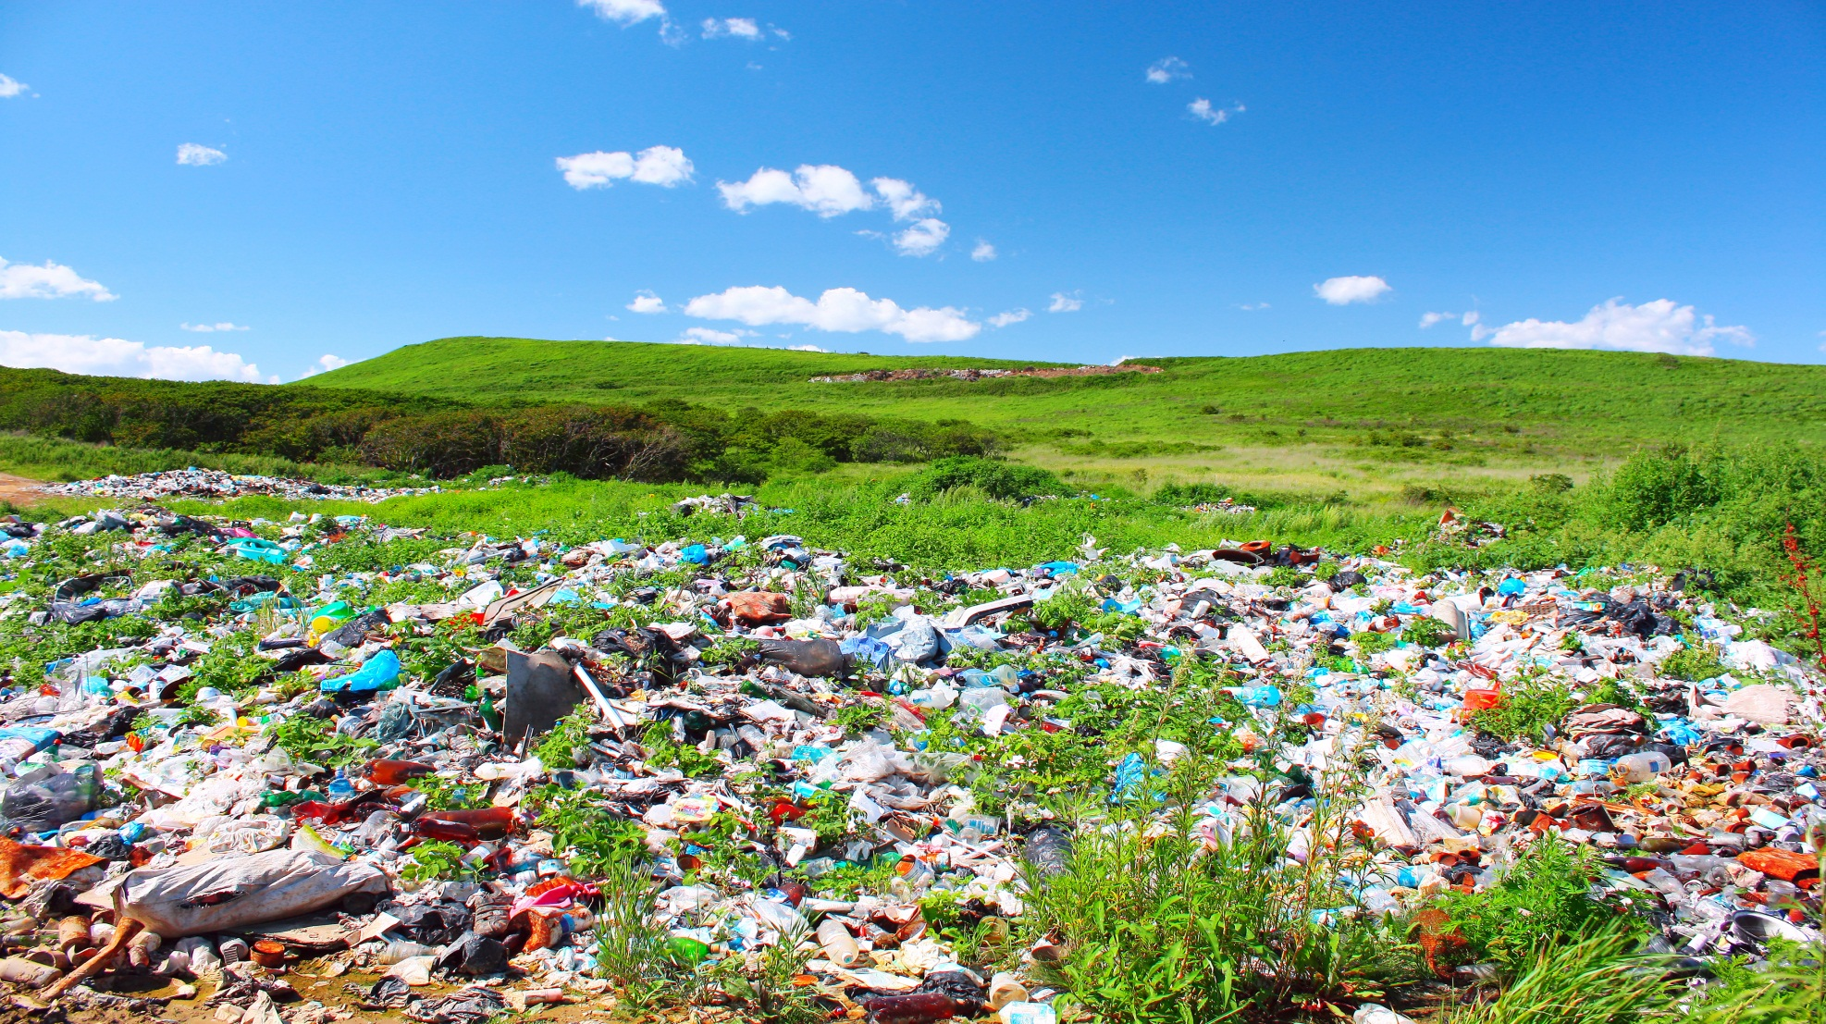
Environmental pollution

Slide 7
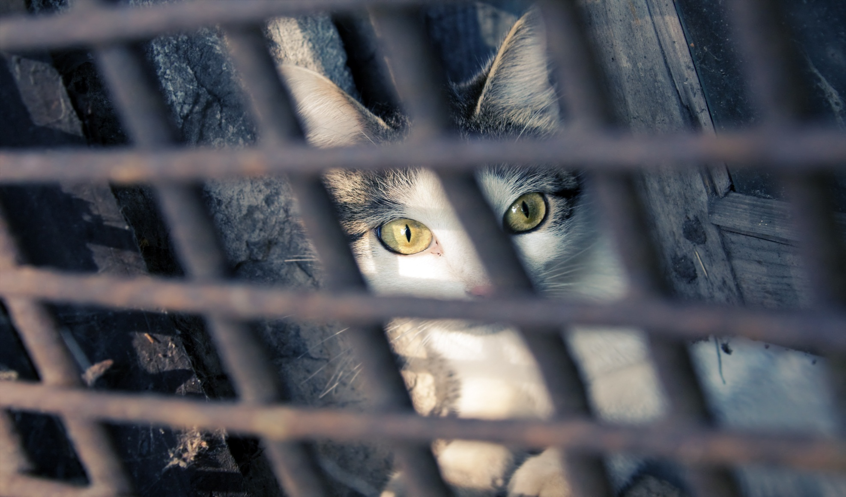
Cruelty to animals

Slide 8
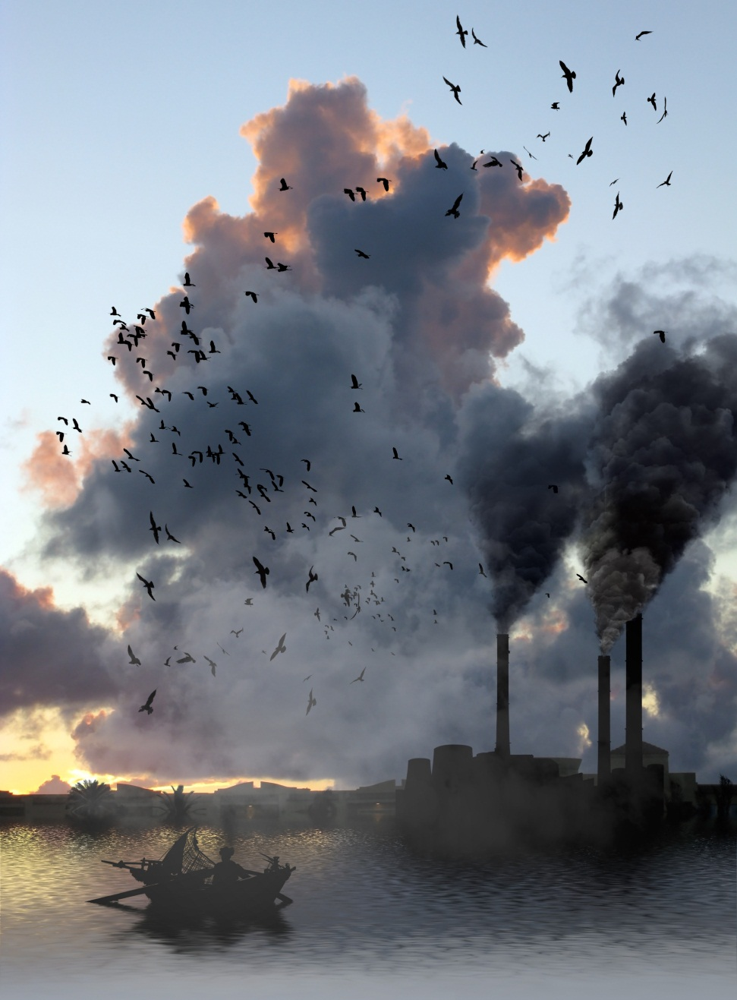
Air pollution

Slide 9
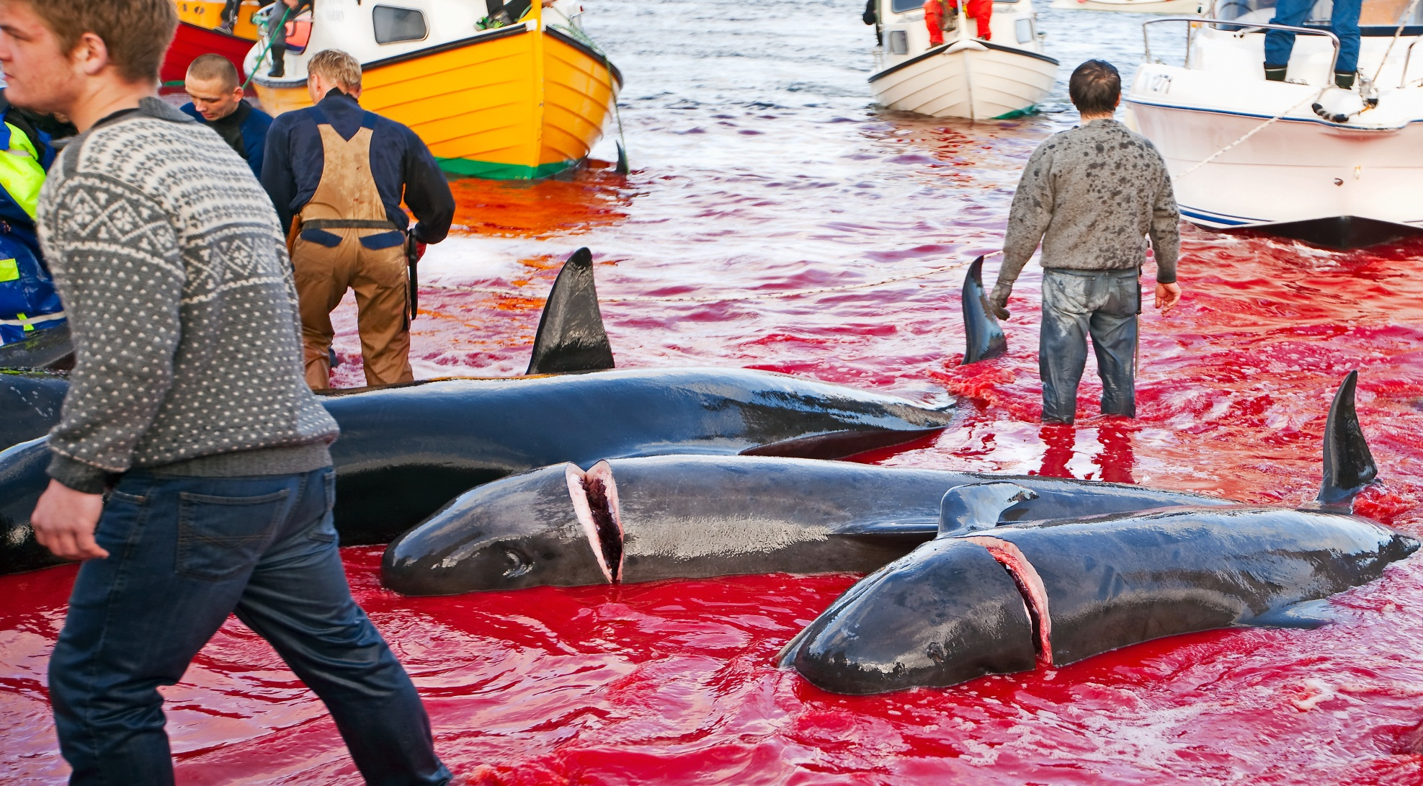
Whaling

Slide 10
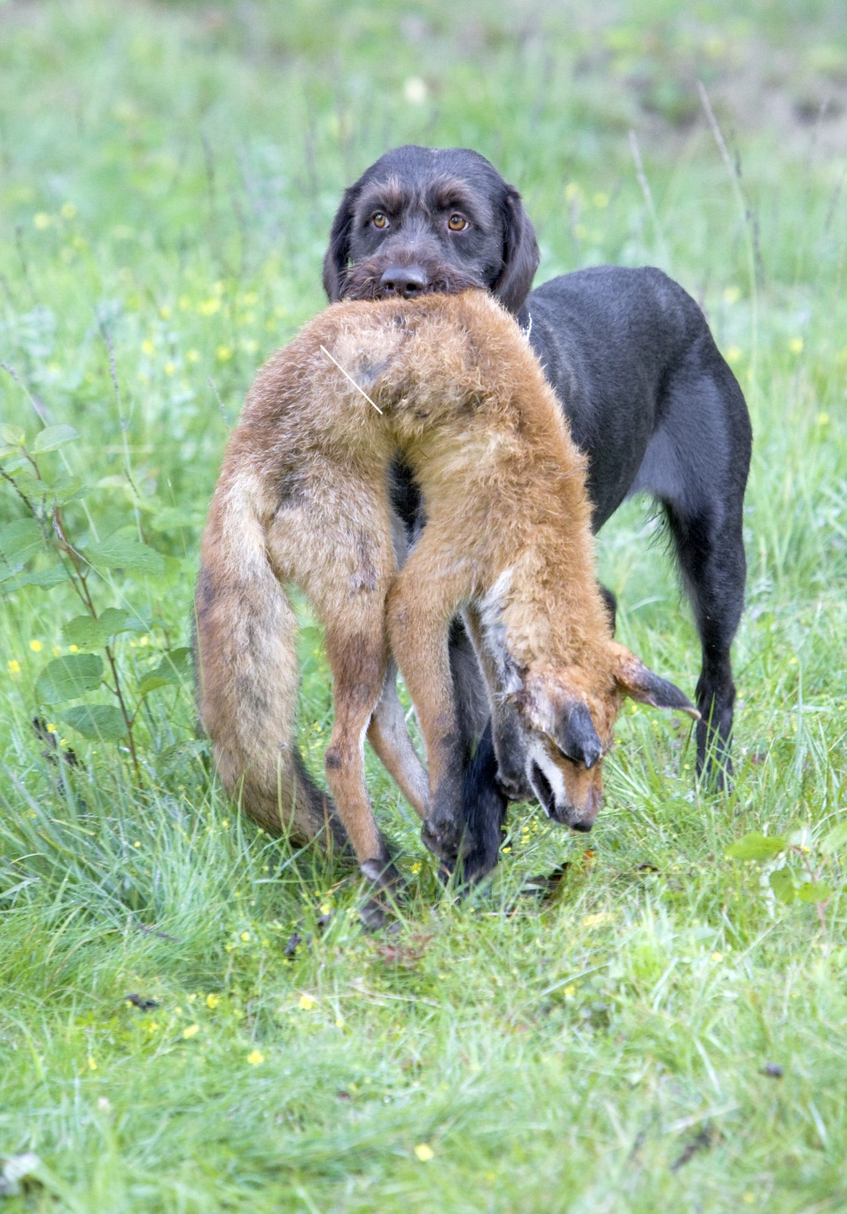
Fox hunting

Slide 11
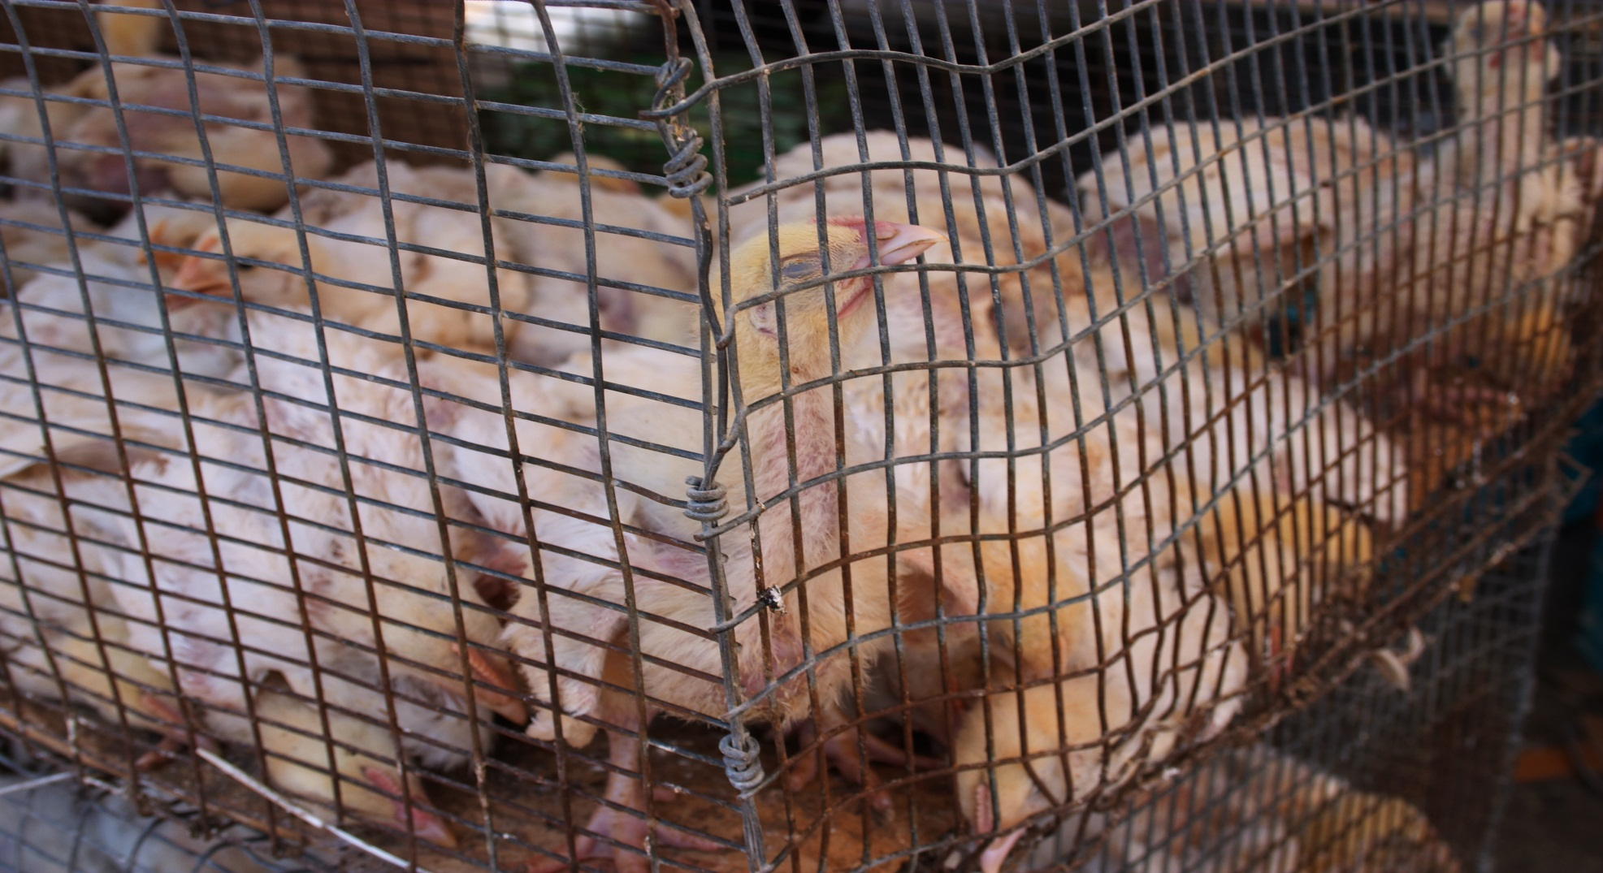
Battery hens

